Slide 1

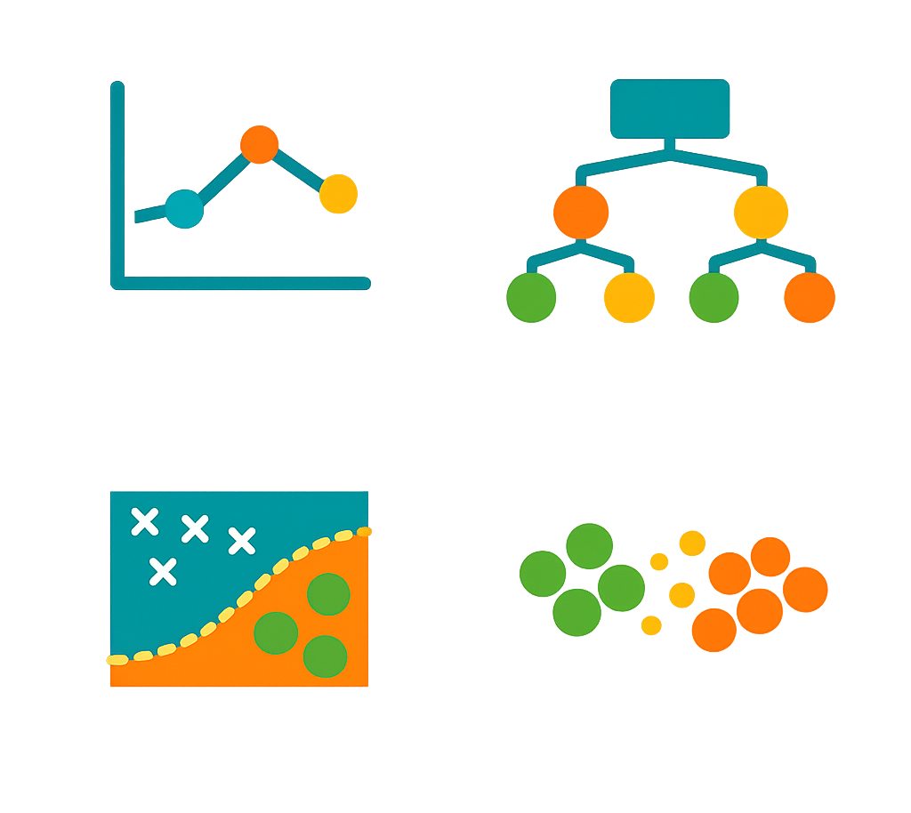
Machine Learning Models
Algorithms and Evaluation
Done by Ahmed Almutairi
Introduction
JRCAI

Slide 2
INTRODUCTION
Presentation Roadmap
01
02
03
04
05
Problem types
Algorithms
Differences
Choose a model
Evaluation
Regression, classification, and clustering
Simple explanation and code for each model
Compare strengths, weaknesses, and best use cases
Match the algorithm to the problem
Measure performance and avoid overfitting
Introduction
JRCAI

Slide 3
PROBLEM TYPES
First: What Type of ML Problem Do We Have?
○
#
✓
Regression
Classification
Clustering
Predicts a number
Predicts a category
Discovers groups
Example
Example
Example
House price, exam score, sales amount
Spam / not spam, pass / fail, fraud / normal
Customer groups, behavior patterns, unlabeled data
Models
Models
Models
Linear Regression
Logistic Regression, Tree, Forest, SVM, KNN, Naive Bayes
K-Means
Problem Types
JRCAI

Slide 4
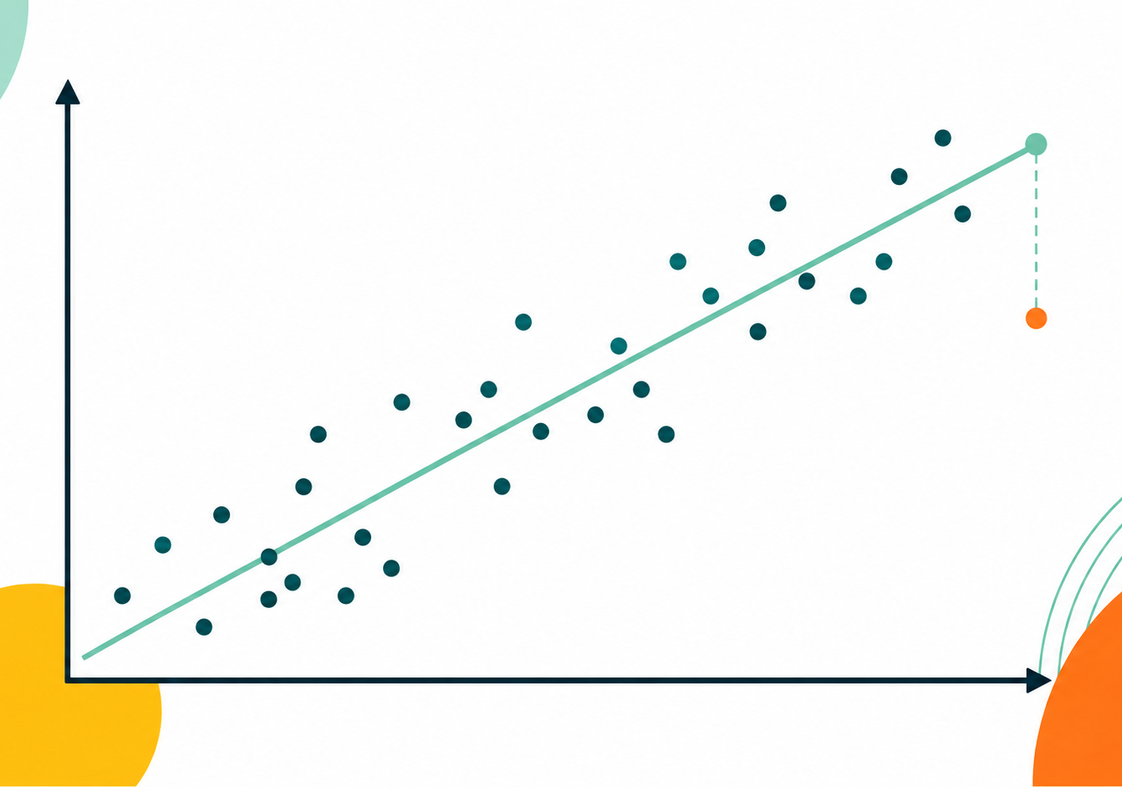
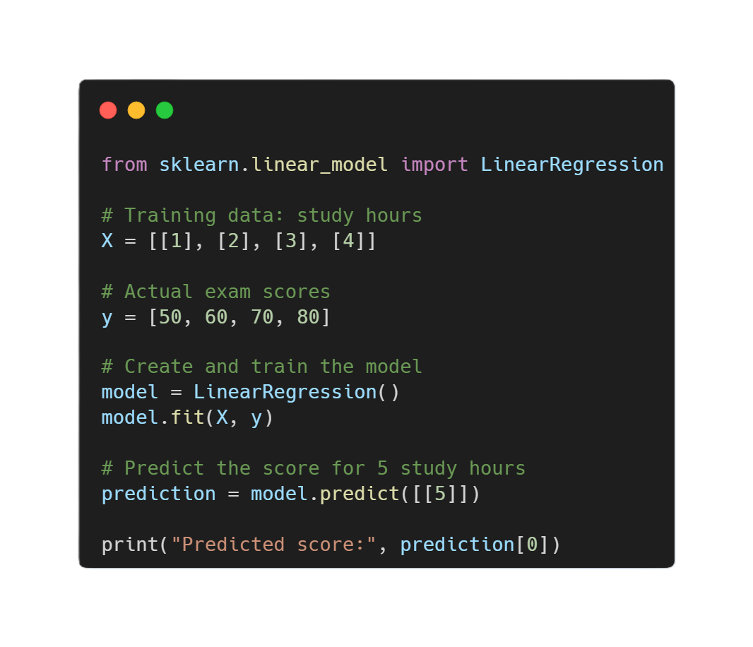
Algorithm
1. Linear Regression
Supervised • Regression
Simple idea
Minimal code
Draws the best straight line to predict a continuous number.
How it works
Learns weights for each feature. The output changes smoothly as the input changes.
Best for
• Prices, scores, sales, time, temperature
In Detail
Linear Regression is used to predict a number, such as a house price, salary, sales amount, or exam score. It learns the relationship between the input features and the output by finding the best-fitting straight line. For example, it can learn how study hours affect exam scores. It works best when the relationship between the input and output is approximately linear.
Watch out
• Weak when the pattern is curved or has many outliers
Algorithms
JRCAI

Slide 5
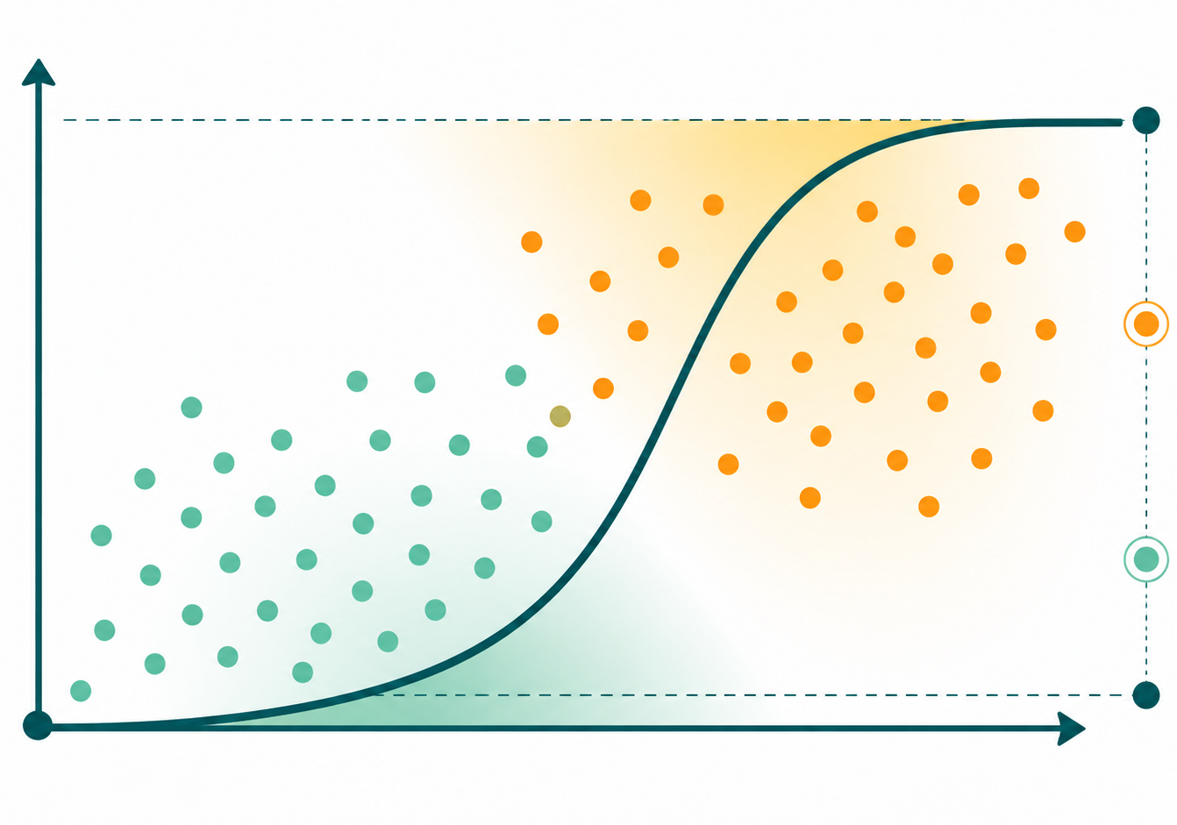
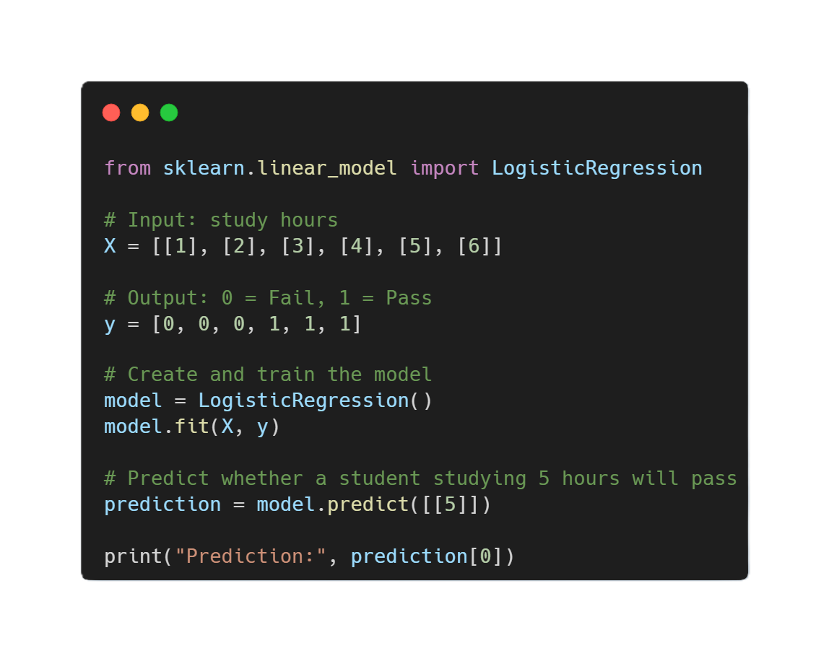
Algorithm
2. Logistic Regression
Supervised • Classification
Simple idea
Minimal code
Predicts the probability that an example belongs to a class.
How it works
Computes a score, converts it into a probability, then uses a threshold such as 0.50.
Best for
• Spam, fraud, pass/fail, churn, simple risk labels
In Detail
Logistic Regression is used to predict a category, such as spam or not spam, pass or fail, and fraud or normal. It calculates the probability that an example belongs to a particular class. For example, it may predict that a student has an 85% chance of passing. Although it is called regression, it is mainly used for classification.
Watch out
• Mostly learns simple boundaries and often needs scaling
Algorithms
JRCAI

Slide 6
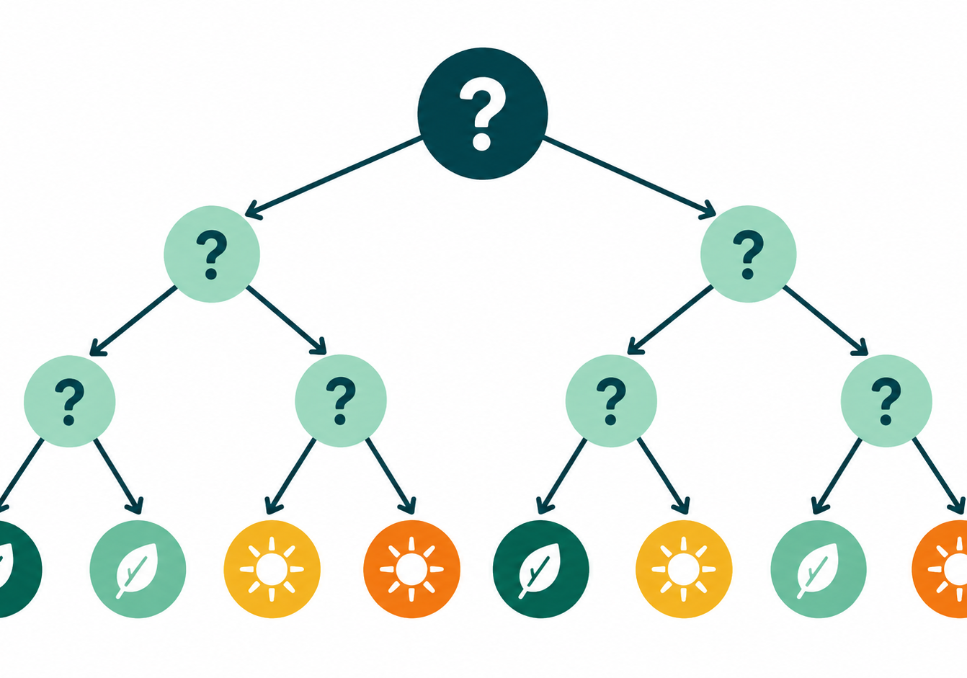
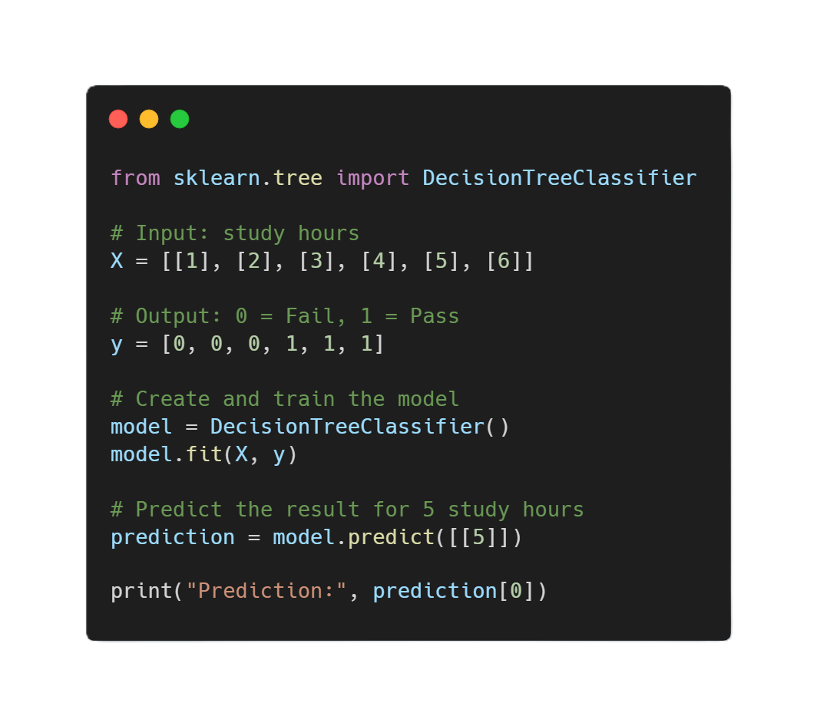
Algorithm
3. Decision Tree
Supervised • Classification / Regression
Simple idea
Minimal code
Works like a flowchart that asks yes/no questions until it reaches an answer.
How it works
Splits data by choosing the feature questions that best separate the target.
Best for
• Explainable rules, mixed data, quick prototypes
In Detail
A Decision Tree makes predictions by asking a series of questions about the data. For example, it may ask whether attendance is above 80%, then whether the previous grade is above 70%. Each answer leads to another branch until the model reaches a final prediction. Decision Trees are easy to understand, but they can overfit by learning the training data too closely.
Watch out
• Can overfit if the tree becomes too deep
Algorithms
JRCAI

Slide 7
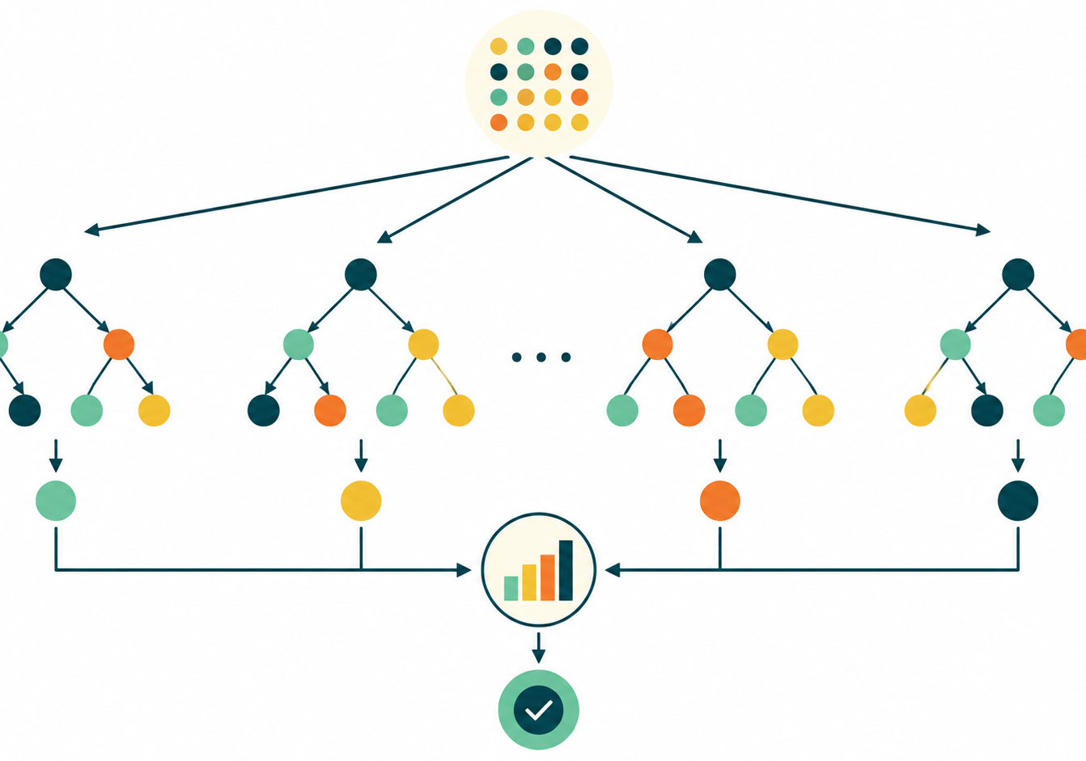
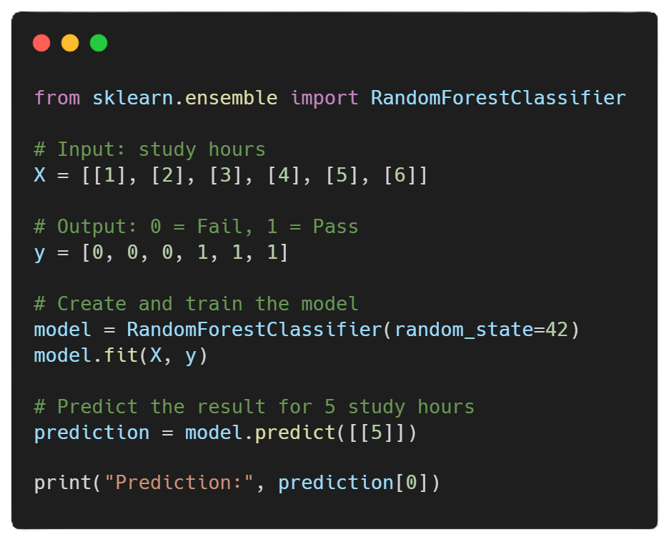
Algorithm
4. Random Forest
Supervised • Classification / Regression
Simple idea
Minimal code
Combines many decision trees and lets them vote or average.
How it works
Each tree learns from a random sample of rows and features. The ensemble is more stable.
Best for
• General tabular data, fraud, churn, risk prediction
In Detail
Random Forest combines many Decision Trees to make a more reliable prediction. Each tree learns from a slightly different sample of the data, and the trees vote for the final answer. For classification, the most common class is selected, while for regression, the predictions are averaged. Random Forest is usually more accurate and less likely to overfit than a single Decision Tree.
Watch out
• Harder to explain than one tree and uses more memory
Algorithms
JRCAI

Slide 8
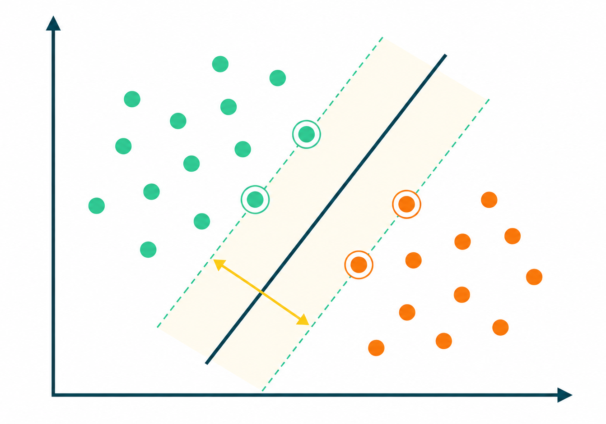
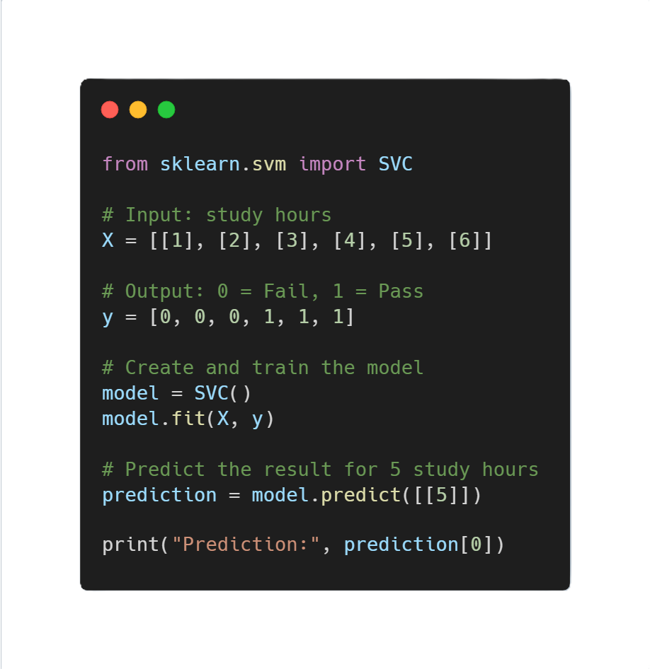
Algorithm
5. Support Vector Machine (SVM)
Supervised • Classification
Simple idea
Minimal code
Finds the best boundary that separates classes with the widest margin.
How it works
Focuses on the closest points to the boundary, called support vectors.
Best for
• Small/medium datasets, text, high-dimensional features
In Detail
A Support Vector Machine, or SVM, is mainly used for classification. It tries to find the best boundary that separates different categories while keeping the largest possible distance between them. For example, it can separate spam emails from normal emails. SVM works well with small or medium-sized datasets, but it normally requires feature scaling and can be slow with very large datasets.
Watch out
• Needs feature scaling and can be slow on large datasets
Algorithms
JRCAI

Slide 9
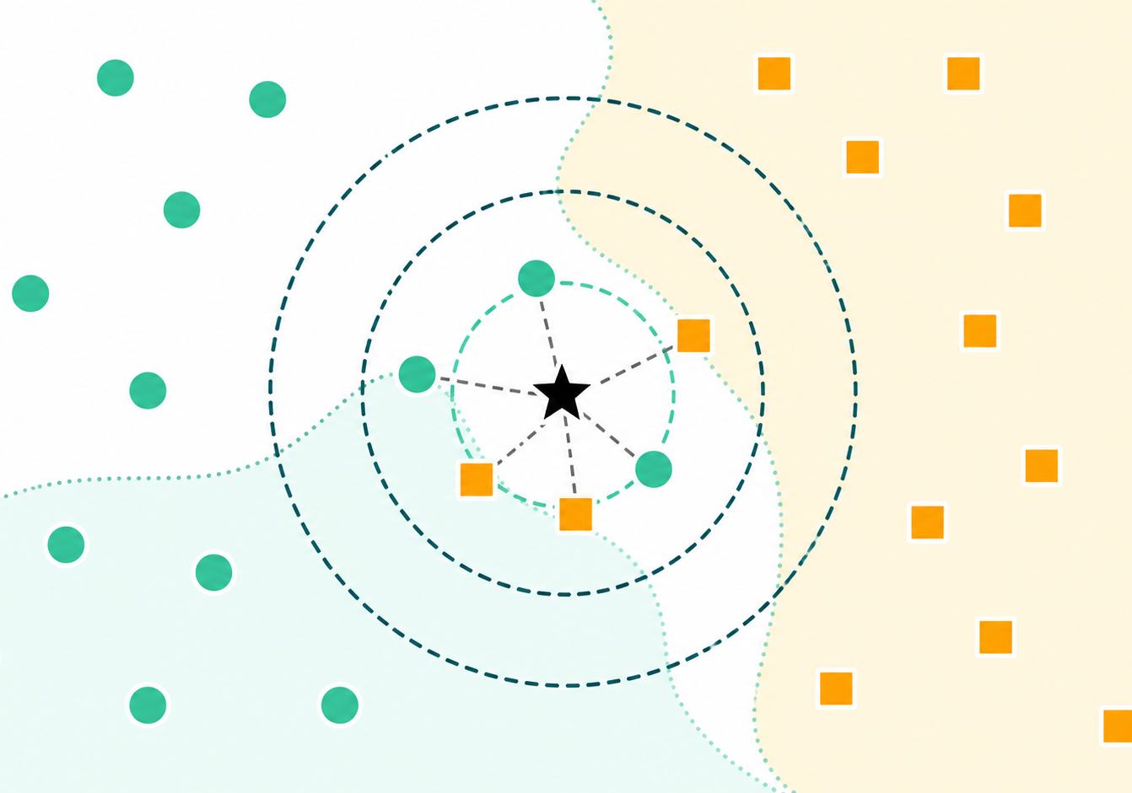
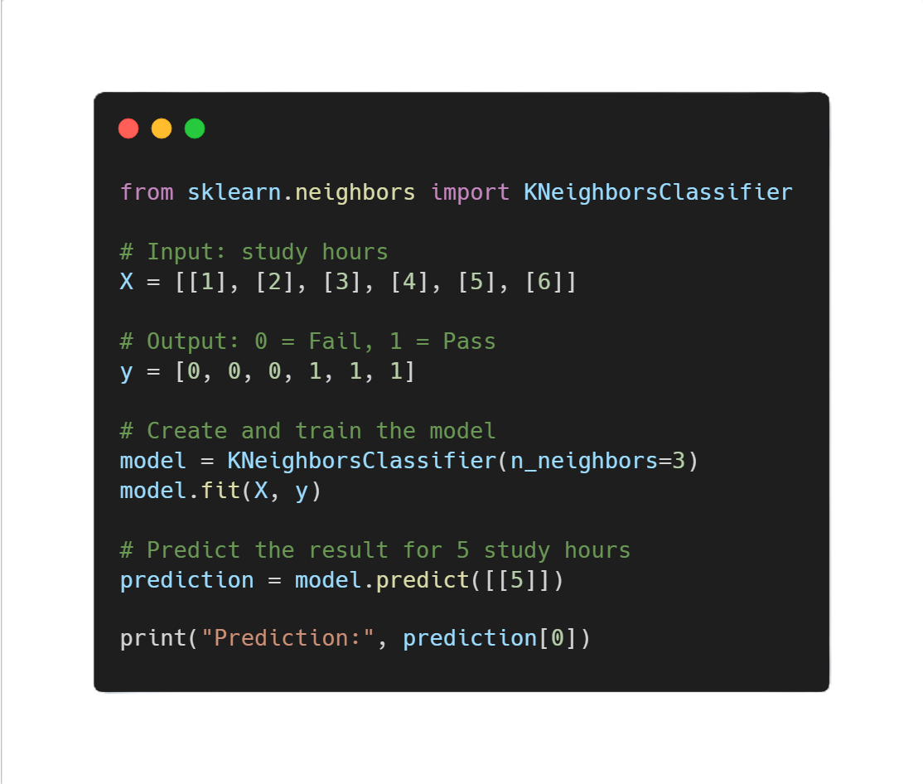
Algorithm
6. K-Nearest Neighbors (KNN)
Supervised • Classification
Simple idea
Minimal code
Predicts from the most similar nearby examples.
How it works
Finds the K closest points and chooses the most common class among them.
Best for
• Small datasets, pattern recognition, simple recommendations
In Detail
K-Nearest Neighbors, or KNN, makes predictions by examining the most similar examples in the dataset. The letter K represents the number of nearby examples used. For example, if most of the five nearest students passed, the model may predict that a new similar student will also pass. KNN is simple, but prediction can become slow when the dataset is large.
Watch out
• Slow prediction on large data and very sensitive to scaling
Algorithms
JRCAI

Slide 10
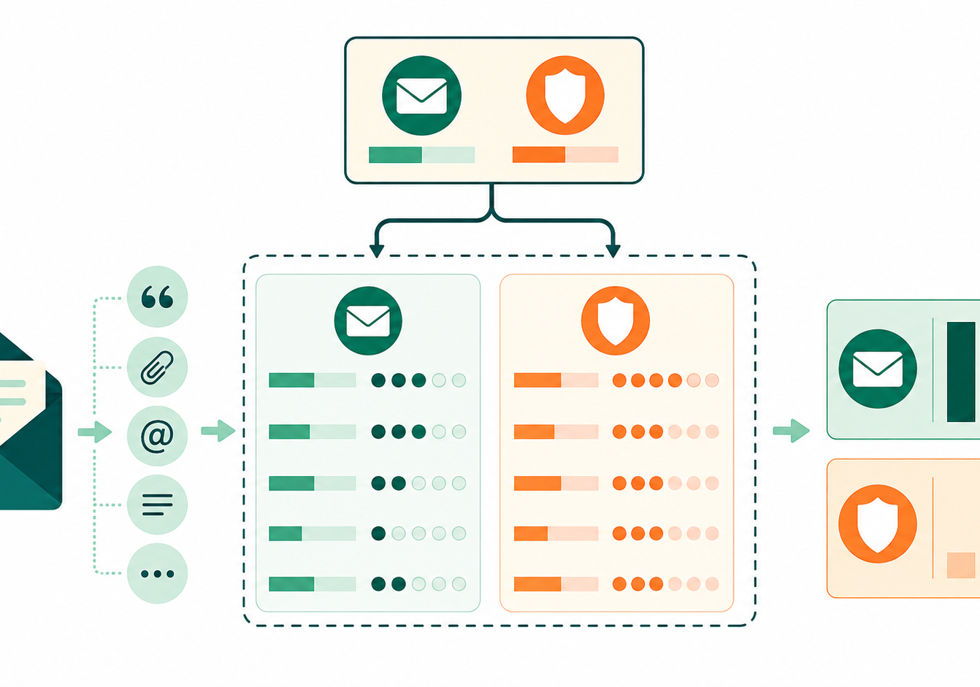
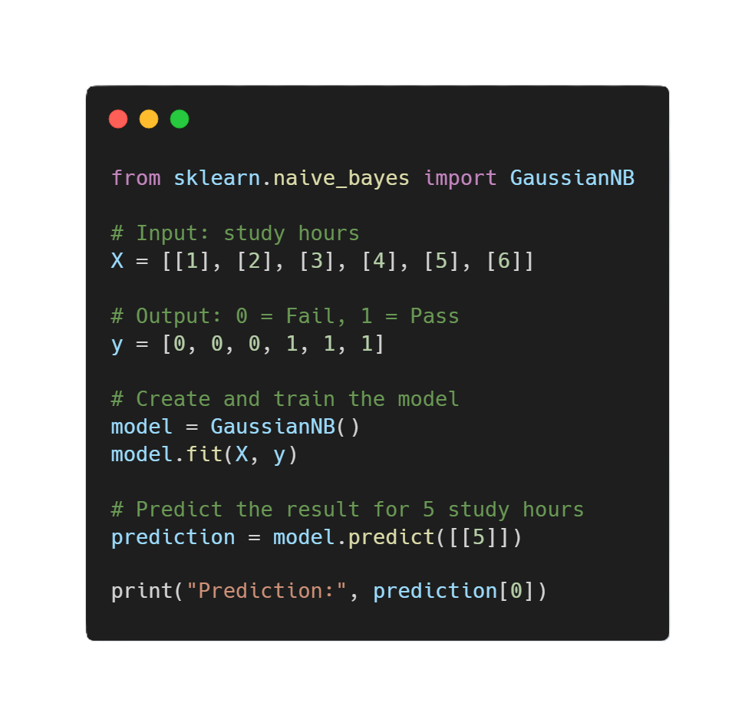
Algorithm
7. Naive Bayes
Supervised • Classification
Simple idea
Minimal code
Chooses the class with the highest probability.
How it works
Uses Bayes’ theorem and assumes features are independent from each other.
Best for
• Text classification, spam detection, sentiment analysis
In Detail
Naive Bayes is a classification algorithm that uses probability to choose the most likely category. For example, it can classify an email as spam by checking words such as “free,” “winner,” or “prize.” It assumes that the input features are independent from each other, which is why it is called “naive.” It is very fast and is especially useful for text classification.
Watch out
• Can miss relationships between features
Algorithms
JRCAI

Slide 11
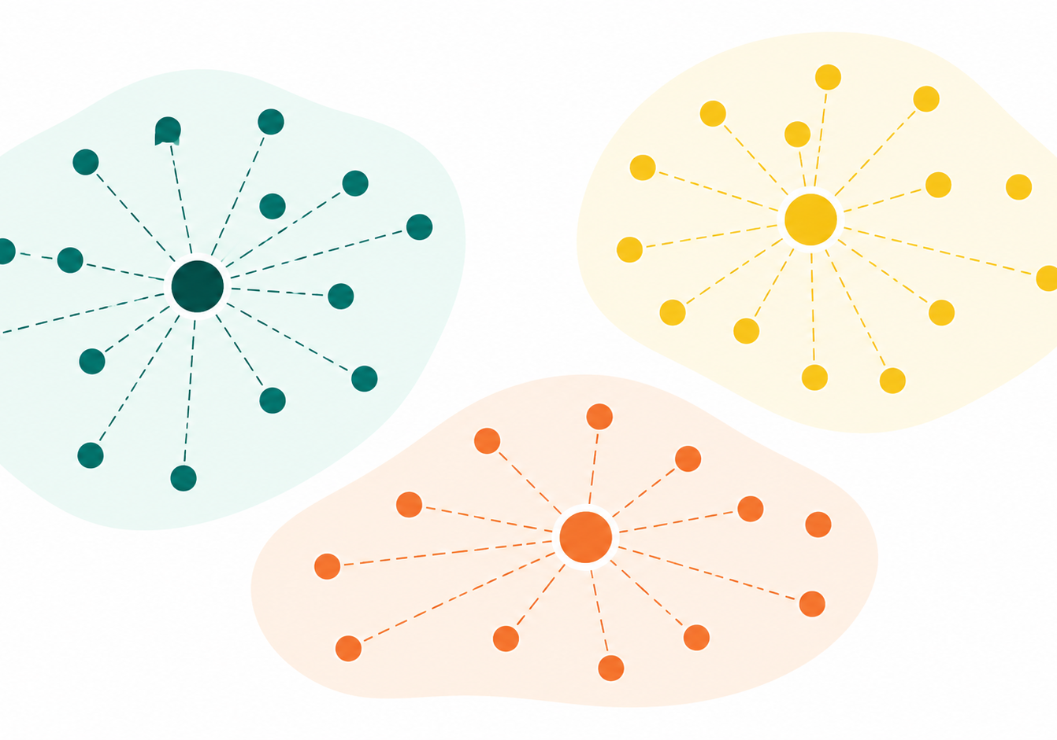
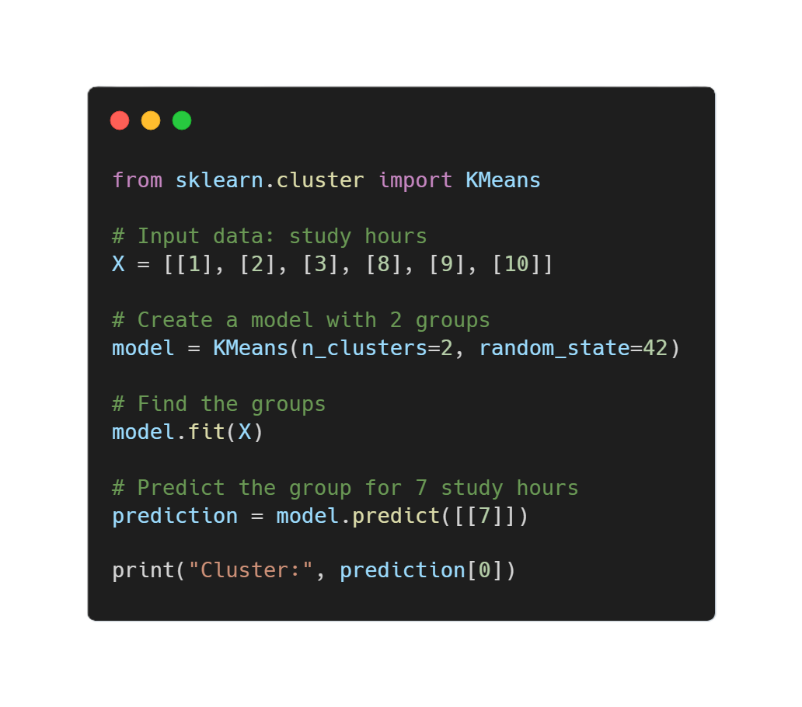
Algorithm
8. K-Means
Unsupervised • Clustering
Simple idea
Minimal code
Groups similar unlabeled examples into clusters.
How it works
Chooses K centers, assigns points to the closest center, and repeats until stable.
Best for
• Customer segmentation, grouping behavior, discovery tasks
In Detail
K-Means is an unsupervised learning algorithm used to group similar data into clusters. Unlike classification models, it does not need existing labels or correct answers. For example, it can group customers based on their spending and purchasing behavior. The user chooses the number of groups, called K, and the model repeatedly moves data points into the nearest cluster until the groups become stable.
Watch out
• You must choose K and scale features first
Algorithms
JRCAI

Slide 12
COMPARE
How the 8 Algorithms Are Different
Algorithm
Type
Scaling?
Limitation
Main strength
Linear Regression
Regression
Sometimes
Weak with complex patterns
Simple numeric prediction
Logistic Regression
Classification
Recommended
Simple decision boundary
Strong baseline
Decision Tree
Both
No
Can Overfit
Rules and interpretation
Random Forest
Both
No
Harder to explain
Accuracy and stability
SVM
Classification
Yes
Needs Scaling
Complex boundaries
KNN
Classification
Yes
Slow on large data
Similarity based prediction
Naive Bayes
Classification
Usually no
Assume Independence
Fast text classification
K-Means
Clustering
Yes
Must Choose K
Discovering groups
Key message: no single algorithm is always best. The right model depends on the problem type, data size, feature quality, interpretability, and evaluation results.
Comparison
JRCAI

Slide 13
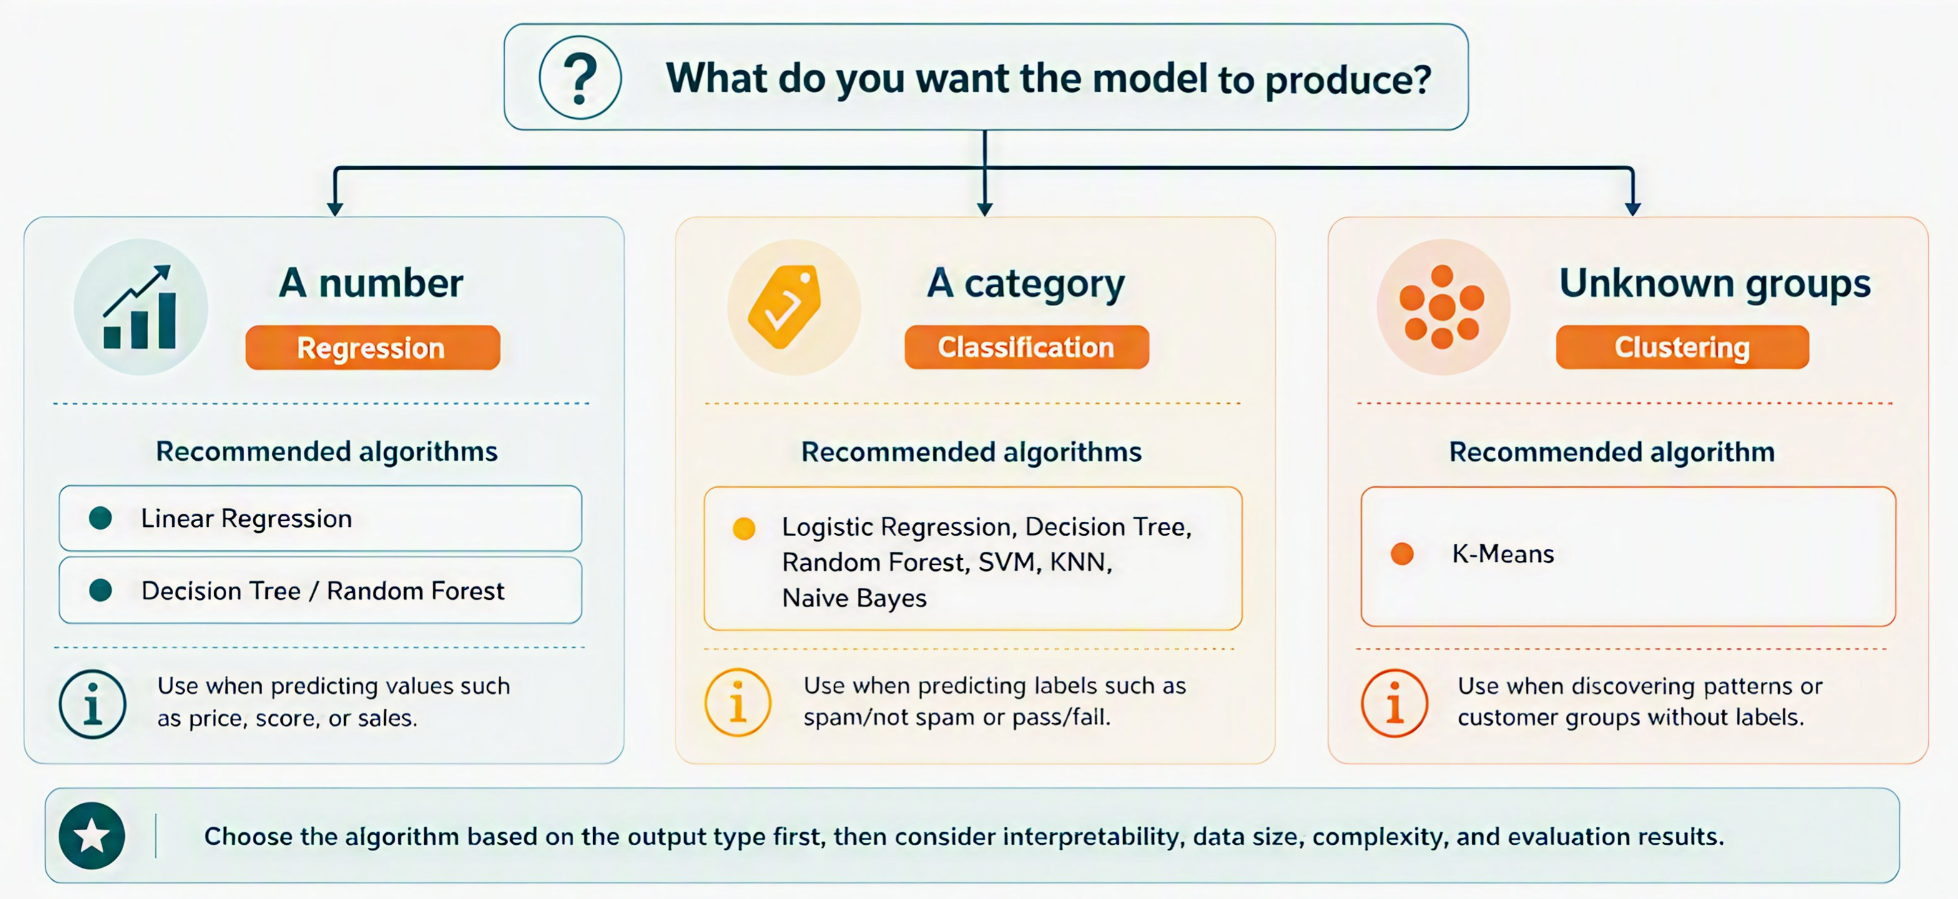
MODEL SELECTION
How to Choose the Right Category and Model
Model Selection
JRCAI

Slide 14
EVALUATION
Model Evaluation: Does the Model Really Work?
Training a model is not enough. We must measure how well it performs on new data.
70%
15%
15%
Training set
Validation set
Testing set
Model learns patterns
Choose settings and compare models
Final unbiased evaluation
Simple rule: train on training data, tune on validation data, report final performance on testing data.
Evaluation
JRCAI

Slide 15
EVALUATION
Evaluation for Classification Models
Accuracy
How many total predictions were correct?
(TP + TN) / Total
Precision
Can I trust a positive prediction?
TP / (TP + FP)
Recall
How many real positives did it find?
TP / (TP + FN)
F1-score
Balance between precision and recall
2PR / (P + R)
ROC-AUC
How well does it separate classes?
0.5 random → 1.0 perfect
Use classification report to see precision, recall, F1-score, and support for every class.
Evaluation
JRCAI

Slide 16
EVALUATION
Evaluation for Regression Models
MAE
MSE
R²
Mean Absolute Error
Mean Squared Error
Coefficient of Determination
Average mistake size
Punishes large mistakes more
How much variation the model explains
Lower is better
Lower is better
Higher is better
For a complete regression evaluation, use MAE, MSE, and R² together.
Evaluation
JRCAI

Slide 17
EVALUATION
Overfitting and Generalization
Overfitting
Generalization
The model memorizes training data but fails on new data.
The model performs well on unseen real-world data.
  Example:
  Training accuracy: 99%
  Testing accuracy: 70%
  Example:
  Training accuracy: 88%
  Testing accuracy: 85%
Goal: close performance between training, validation, and testing data.
Fix overfitting by using more data, simpler models, regularization, pruning, or cross-validation.
Evaluation
JRCAI

Slide 18
SUMMARY
Final Takeaways
1
Identify the problem type
Number, category, or groups?
2
Choose candidate algorithms
Start simple, then compare stronger models.
3
Split your data correctly
Training, validation, and testing.
4
Use the right metrics
Classification and regression need different metrics.
5
Check generalization
The model must work on new data.
Machine learning is not only about training models, but also about choosing the right model and proving it works.
Summary
JRCAI

Slide 19
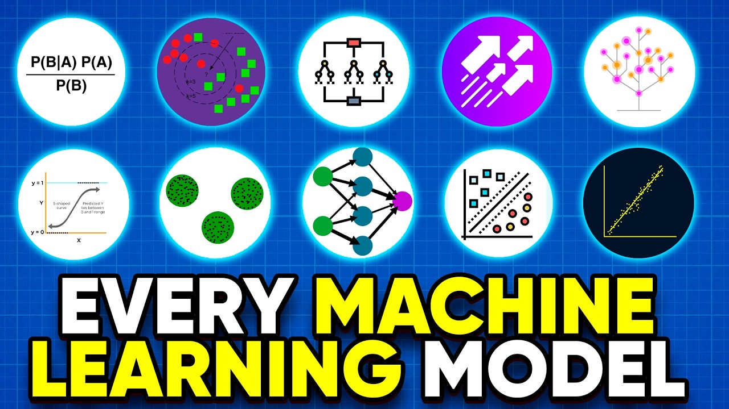
Video
Learn more.
Click The Image
All Machine Learning algorithms explained in 17 min
https://www.youtube.com/watch?v=E0Hmnixke2g
Summary
JRCAI

Slide 20
SUMMARY
Final
Thank You.
Done by Ahmed Almutairi
-
JRCAI

